Slide 1
Illumination and Shading

Slide 2
Illumination Vs. Shading
Illumination (lighting) model: determine the color of a surface point by simulating some light attributes.
Shading model: applies the illumination models at a set of points and colors the whole image.

Slide 3
Illumination (Lighting) Model
To model the interaction of light with surfaces to determine the final color & brightness of the surface
Global illumination
Local illumination

Slide 4
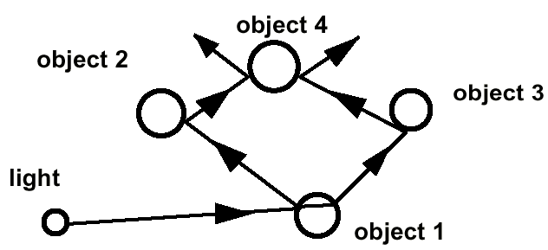
Global Illumination
Global Illumination models: take into account the interaction of light from all the surfaces in the scene. (will cover under the Radiosity section)

Slide 5
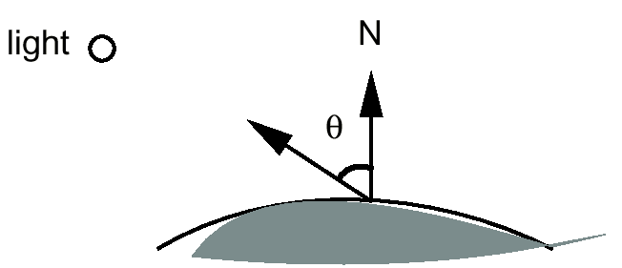
Local illumination
Only consider the light, the observer position, and the object material properties

Slide 6
Basic Illumination Model
Simple and fast method for calculating surface intensity at a given point
Lighting calculation are based on:
The background lighting conditions
The light source specification: color, position
Optical properties of surfaces:
Glossy OR matte
Opaque OR transparent (control refection and absorption)

Slide 7
Ambient light (background light)
The light that is the result from the light reflecting off other surfaces in the environment
A general level of brightness for a scene that is independent of the light positions or surface directions -> ambient light
Has no direction
Each light source has an ambient light contribution, Ia
For a given surface, we can specify how much ambient light the surface can reflect using an ambient reflection coefficient : Ka (0 < Ka < 1)

Slide 8
Ambient Light
So the amount of light that the surface reflect is therefore
Iamb = Ka * Ia

Slide 9
Diffuse Light
The illumination that a surface receives from a light source and reflects equally in all directions
This type of reflection is called Lambertian Reflection (thus, Lambertian surfaces)
The brightness of the surface is indepenent of the observer position (since the light is reflected in all direction equally)

Slide 10
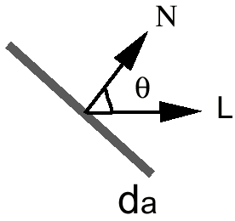
Lambert’s Law
How much light the surface receives from a light source depends on the angle between its angle and the vector from the surface point to the light (light vector)
Lambert’s law: the radiant energy ’I_{d}’ from a small surface d_{a} for a given light source is:
I_{d} = I_{L} * cos(θ)
I_{L} : the intensity of the light source
is the angle between the surface
normal (N) and light vector (L)

Slide 11
The Diffuse Component
Surface’s material property: assuming that the surface can reflect K_{d} (0<K_{d}<1), diffuse reflection coefficient) amount of diffuse light:
I_{diff} = K_{d} * I_{L} * cos(θ)
If N and L are normalized, cos(θ) = N*L
I_{diff} = K_{d} * I_{L} * (N*L)
The total diffuse reflection = ambient + diffuse
I_{diff} = K_{a} * I_{a} + K_{d} * I_{L} * (N*L)

Slide 12
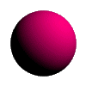
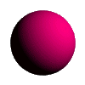
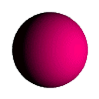
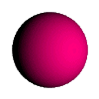
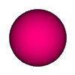
Examples
Sphere diffusely lighted from various angles !

Slide 13
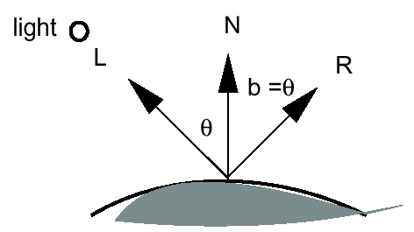
Specular Light
These are the bright spots on objects (such as polished metal, apple ...)
Light reflected from the surface unequally to all directions.
The result of near total reflection of the incident light in a concentrated region around the specular reflection angle

Slide 14
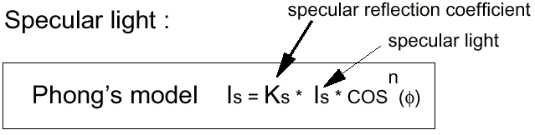
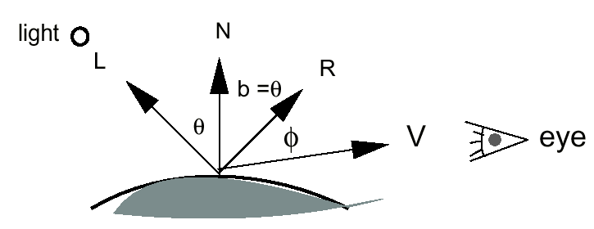
Phong’s Model for Specular
How much reflection light you can see depends on where you are

Slide 15
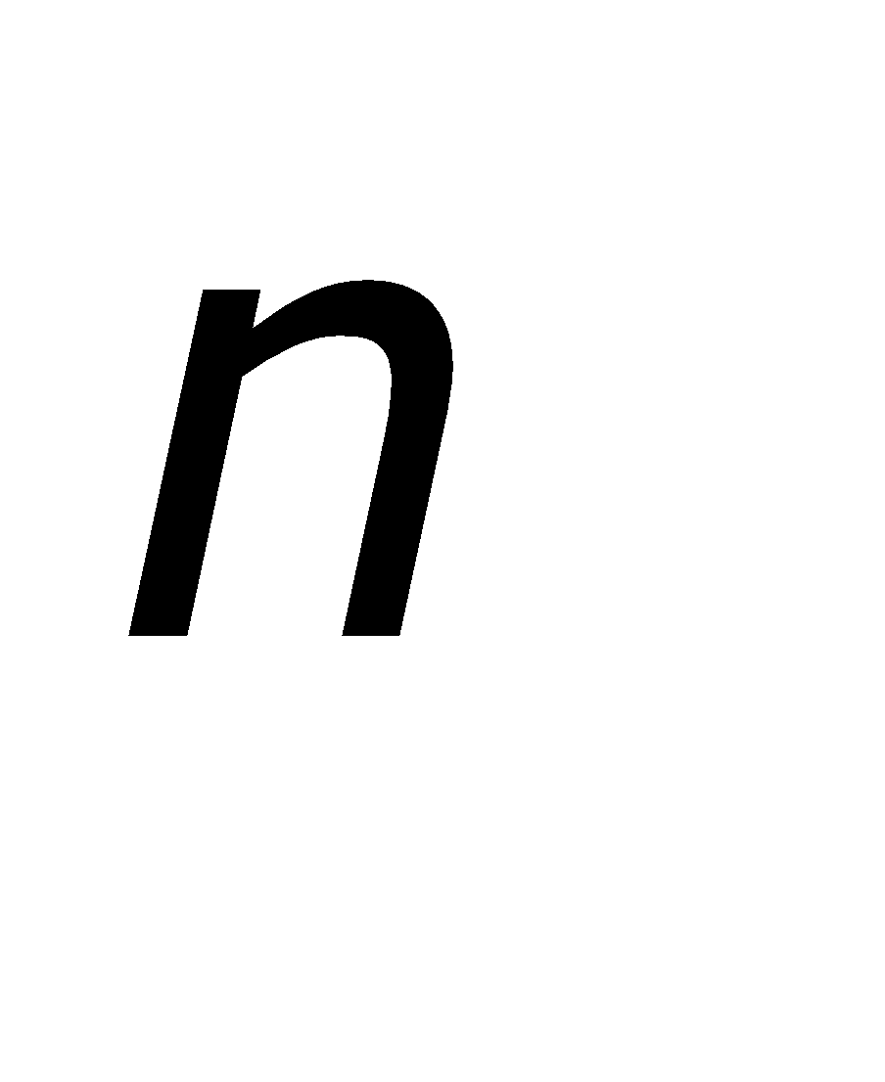
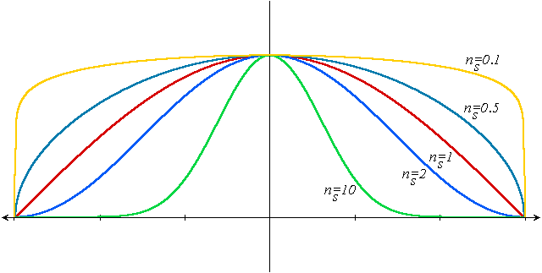
Phong Illumination Curves
Specular exponents are much larger than 1;
Values of 100 are not uncommon.
: glossiness, rate of falloff

Slide 16
Specular Highlights
Shiny surfaces change appearance when viewpoint is changed
Specularities are caused by microscopically smooth surfaces.
A mirror is a perfect specular reflector

Slide 17
Reflected Ray
N
How to calculate R? R + L = 2(N*L) N
R = 2(N*L) N - L
L
R
φ
φ
α
V
2N(N•L)
L
N(N•L)
L
L
R = 2N(N•L) - L
φ
φ
φ
φ
Project L onto N
Double length of vector
Subtract L

Slide 18
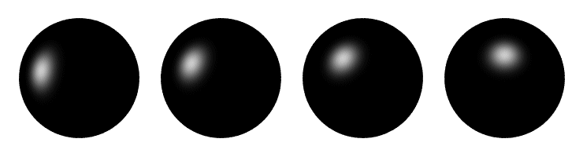
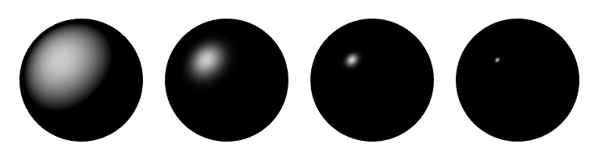
Phong Illumination
Moving Light
Change n

Slide 19
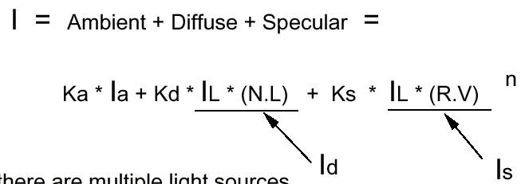
Putting It All Together
Single Light (white light source)

Slide 20

Multiple Light Source
I_{L}: light intensity
For multiple light sources
Repeat the diffuse and specular calculations for each light source
Add the components from all light sources
The ambient term contributes only once
The different reflectance coefficients can differ.
Simple “metal”: k_{s} and k_{d} share material color,
Simple plastic: k_{s} is white
Remember, when cosine is negative lighting term is zero!

Slide 21
Shading Models for Polygons
Constant Shading (flat shading)
Compute illumination at any one point on the surface. Use face or one normal from a pair of edges. Good for far away light and viewer or if facets approximate surface well.
Per-Pixel Shading
Compute illumination at every point on the surface.
Interpolated Shading
Compute illumination at vertices and interpolate color

Slide 22
Constant Shading
Compute illumination only at one point on the surface
Okay to use if all of the following are true
The object is not a curved (smooth) surface (e.g. a polyhedron object)
The light source is very far away (so N.L does not change much across a polygon)
The eye is very far away (so V.R does not change much across a polygon)
The surface is quite small (close to pixel size)

Slide 23
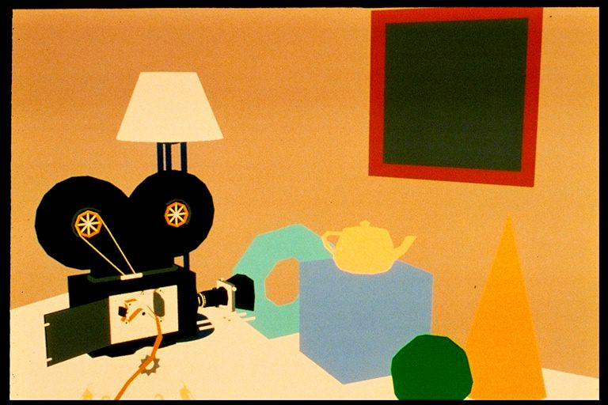
Un-lit

Slide 24
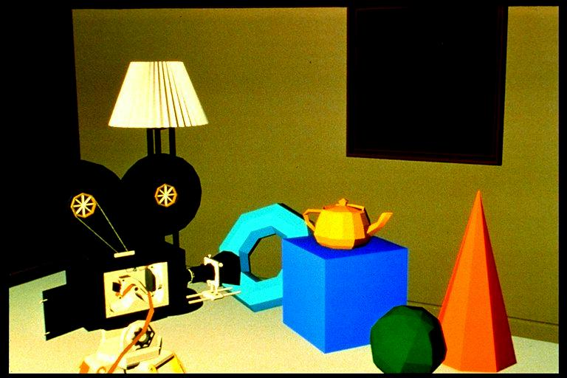
Flat Shading

Slide 25
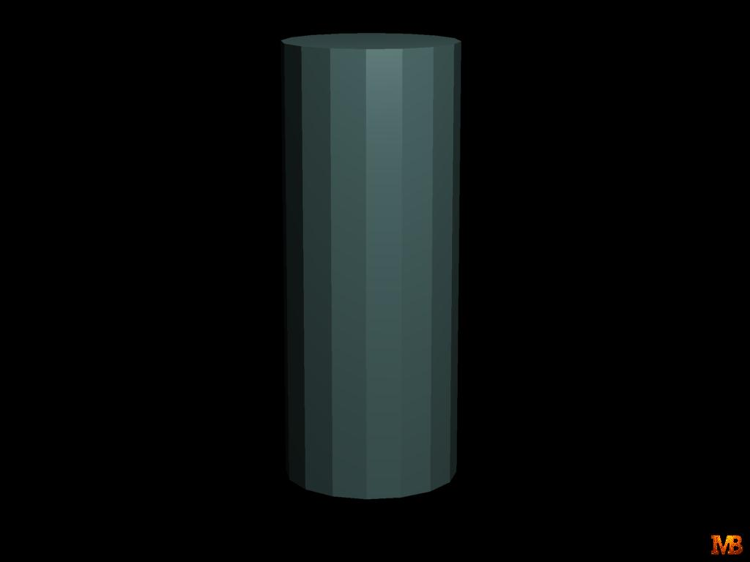
Mach Band ?

Slide 26
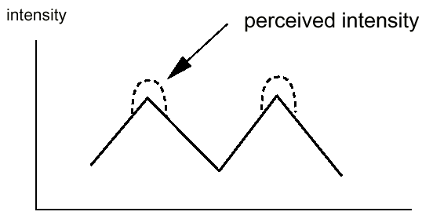
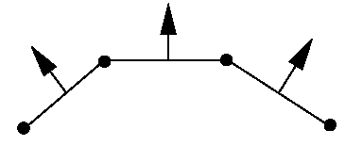
Polygon Mesh Shading
Shading each polygonal facet individually will not generate an illusion of smooth curved surface
Reason: polygons will have different colors along the boundary, unfortunately, human perception helps to even accentuate the discontinuity: mach band effect

Slide 27
Mach Banding
Intensity change is exagerated
Dark facet looks darker and lighter looks even more lighter

Slide 28
Smooth Shading
Need to have per-vertex normals
Gouraud Shading
Interpolate color across triangles
Fast, supported by most of the graphics accelerator cards
Phong Shading
Interpolate normals across triangles
More accurate, but slow. Not widely supported by hardware

Slide 29
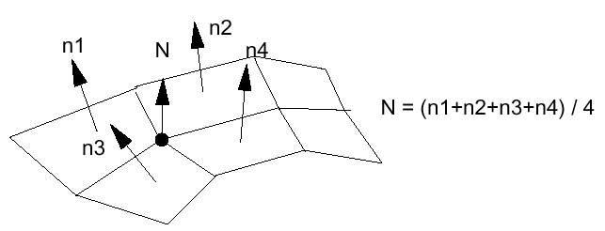
Gouraud Shading
Normals are computed at the polygon vertices
If we only have per-face normals, the normal at each vertex is the average of the normals of its adjacent faces
Intensity interpolation: linearly interpolate the pixel intensity (color) across a polygon surface

Slide 30
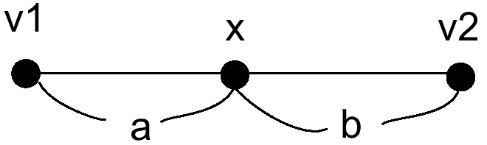
Linear Interpolation
Calculate the value of a point based on
the distances to the point’s two neighbor points
If v1 and v2 are known, then
x = b/(a+b) * v1 + a/(a+b) * v2

Slide 31
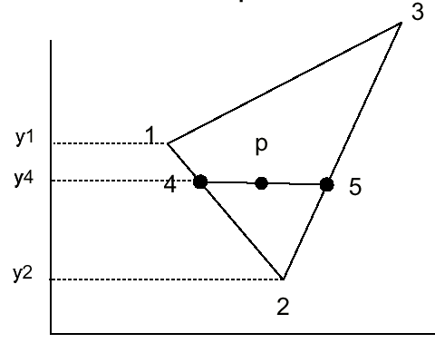
Linear Interpolation in a Triangle
To determine the intensity (color) of point P in the triangle,
we will do:
determine the intensity of 4 by linearly interpolating between 1 and 2
determine the intensity of 5 by linearly interpolating between 2 and 3
determine the intensity of P by linear interpolating between 4 and 5

Slide 32
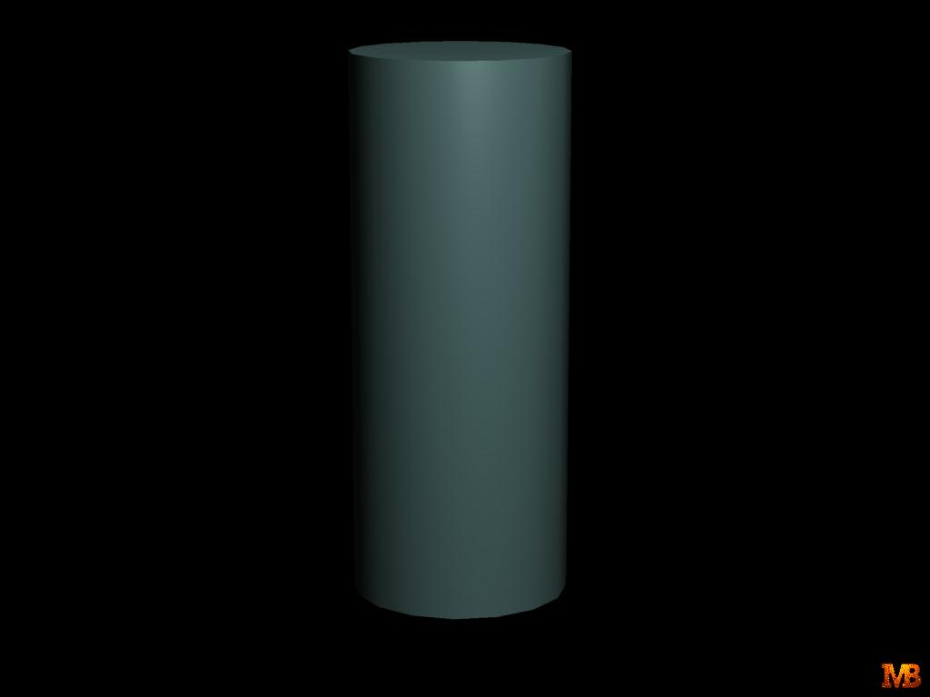
Mach Band ?

Slide 33
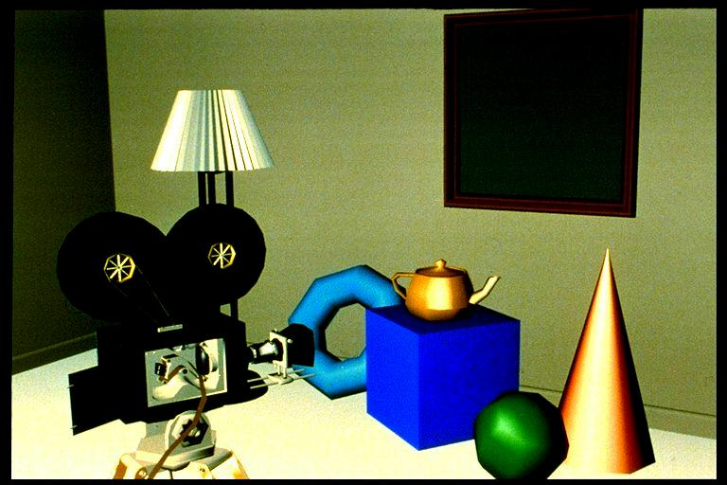
Image

Slide 34
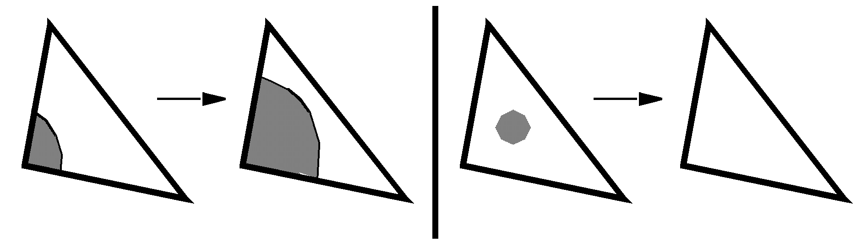
Phong Shading Model
Gouraud shading does not properly handle specular highlights, specially when the n parameter is large (small highlight).
Reason: colors are interpolated.
Solution: (Phong Shading Model)
1. Compute averaged normal at vertices.
2. Interpolate normals along edges and scan-lines. (component by component)
3. Compute per-pixel illumination.

Slide 35
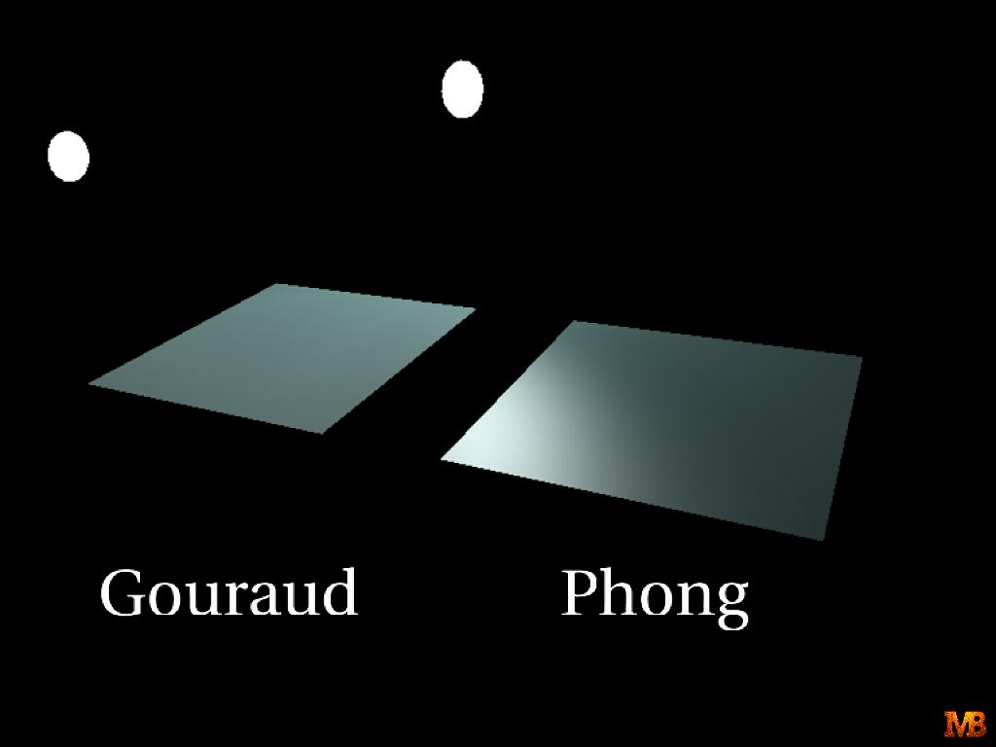

Slide 36
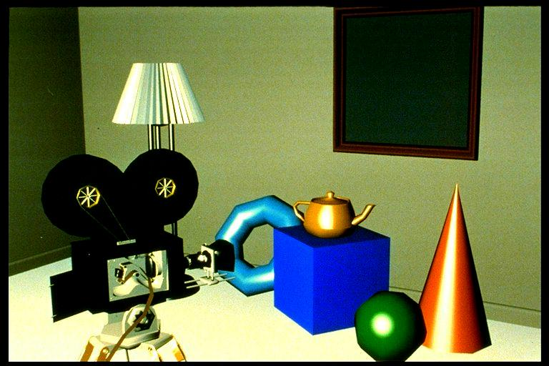

Slide 37
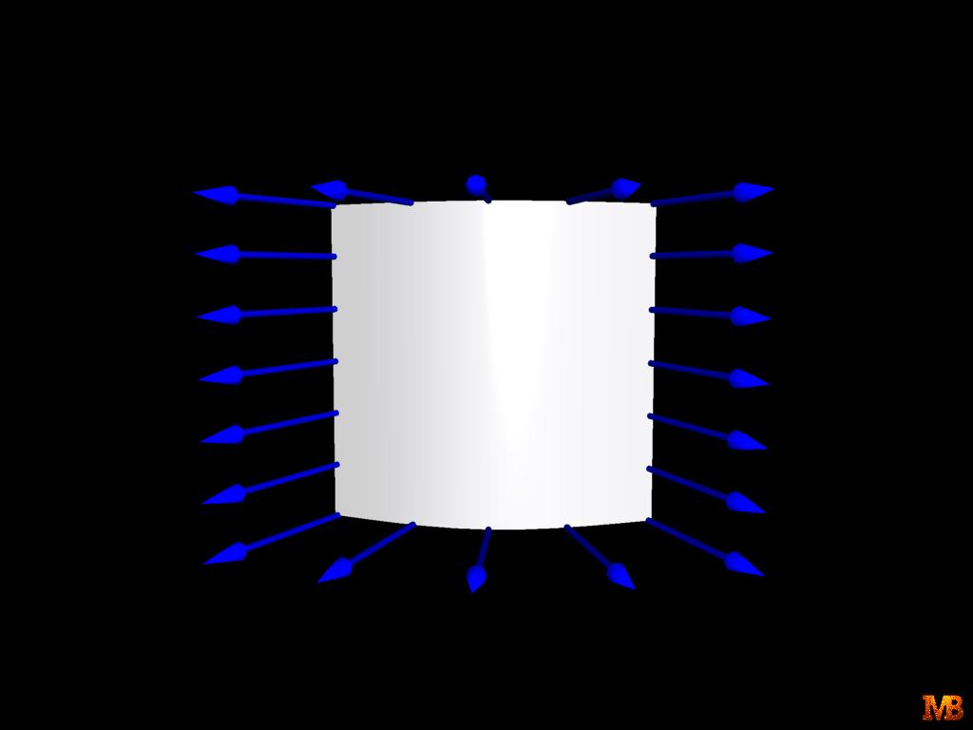
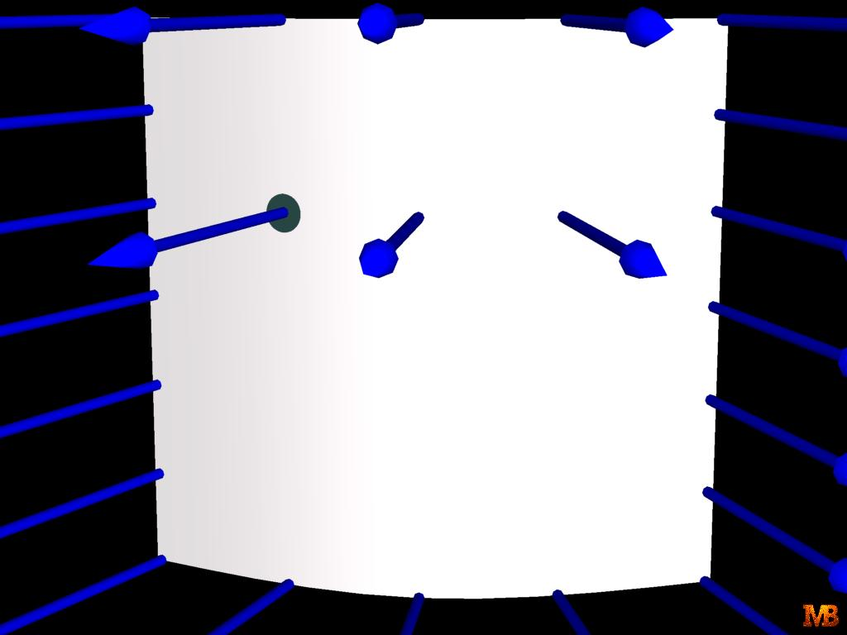
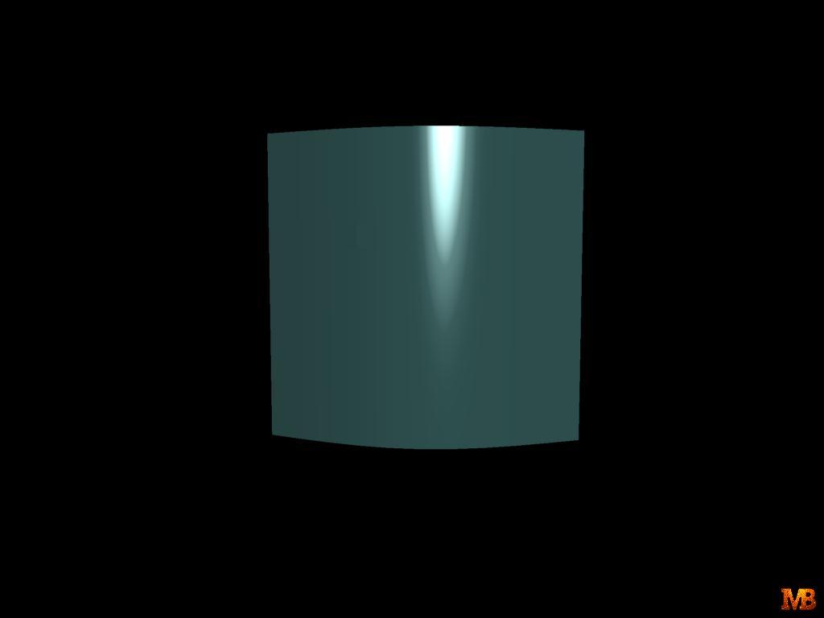

Slide 38
Interpolated Shading - Problems
Polygonal silhouette – edge is always polygonal. Solution ?
Perspective distortion – interpolation is in screen space and hence for-shortening takes place. Solution ?
In both cases finer polygons can help !

Slide 39
Interpolated Shading - Problems
Orientation dependence - small rotations cause problems
A
B
A
C
B
D
D
C

Slide 40
Interpolated Shading - Problems
Problems at shared vertices – shared by right polygons and not by one on left and hence discontinuity
Incorrect Vertex normals – no variation in shade

Slide 41
Light Sources
Point light source
Directional light source: e.g. sun light
Spot light

Slide 42
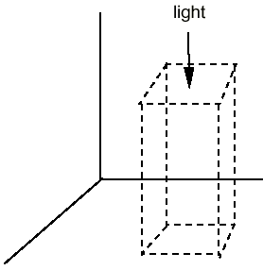
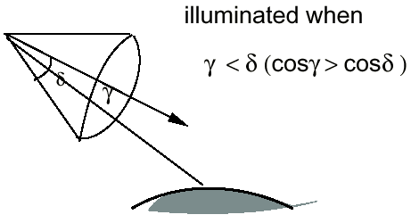
Spot Light
To restrict a light’s effects to a limited area of the scene
Flap: confine the effects of the light to a designed range in x, y, and z world coordinate
Cone: restrict the effects of the light using a cone with a generating angle δ

Slide 43
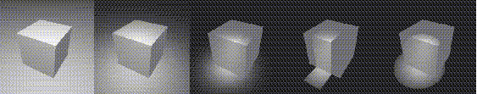
Example

